Slide 1

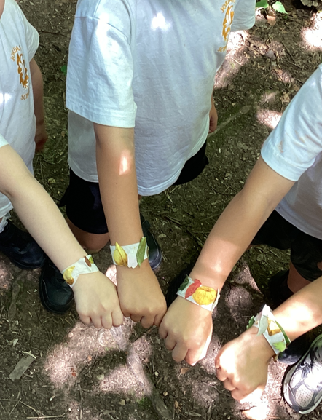
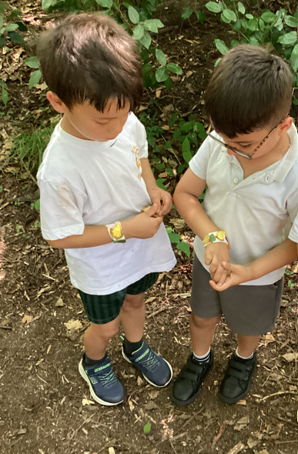
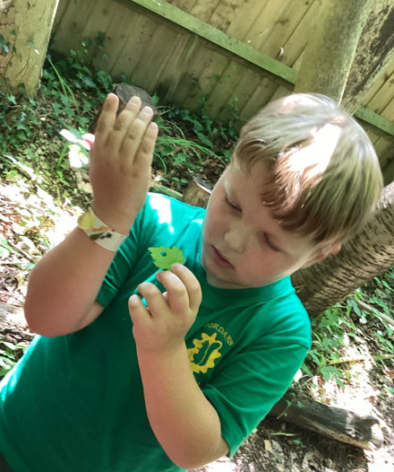
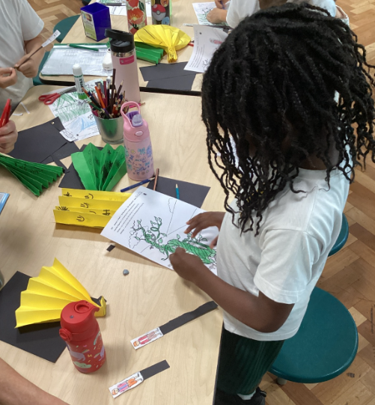

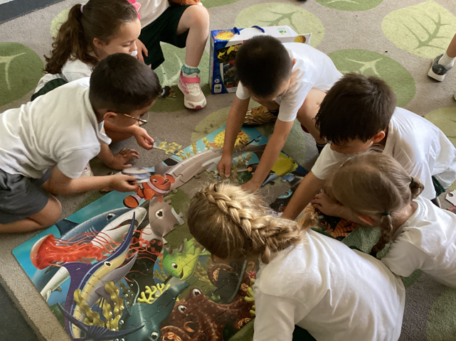
JORDANS SCHOOL
NEWSLETTER
^{26th June, 2026}
A huge thank you to the amazing Jordans Team for keeping everyone cool and the school open during the heatwave.
Special Days
– click below to see!
YR Foxes
Y1 Owls
Y2 Deers

Slide 2





JORDANS SCHOOL
Class News
Fox Class
Owl Class
This week in Fox Class we read ‘A Fish with a Wish’. In Literacy we have focussed on high frequency words and we have been learning the names of the different oceans in the world. Well done, Fox Class!
In Owl Class we have been learning about the seaside; past and present. In PSHE the topic has been our neighbourhoods and we have had lots of discussion about what makes a good neighbourhood. Our book of the week was ‘The Storm Whale’. Well done, Owl Class!
Deer Class
Our Assemblies this week...
This week in Deer Class as part of our Maths lessons we have been learning the value of money. In English we have worked very hard writing autobiographies and we have all been very excited because our caterpillars have turned into chrysalis. Fantastic effort, Deer Class!
Values:
Kindness: Thinking of each other
Cultural Capital:
Glastonbury Festival
Stories from Around the World:
Ali Baba and his Brothers, from Iraq
Music:
Poland Folk Music: Mazurkas
RE:
Kindness
Song:
Dragonfly

Slide 3

JORDANS SCHOOL
Calendar
Upcoming Events
29.6.26 | a.m. End of Year Class Photos.
30.6.26 | 9am. Yr 2 walking to Jordans Quaker Meeting House.
2.7.26 | 9.30am. School Nursing Team -Reception Class vision screening
2.7.26 | 12.40. Yr 2 to Dropmore Country Dancing Festival.
3.7.26 | 9.30am. Sports Day on the Village Green.
3.7.26 | End of Year Reports and attendance data sent home.
7.7.26 | Transition morning.
7.7.26 | 09.45am. New September Reception starters here.
9.7.26 | 3pm. Reception class fundraiser. Cake Sale.
14.7.26 | Yr 2 Leavers’ Assembly to whole school.
16.7.26 | 8.45 – 9.30. Tea/coffee for Yr 2 parents.
16.7.26 | 9.30. Year 2 Leavers’ Assembly.
17.7.26 | 2pm. Break up for Summer holidays.
1.9.26 | INSET DAY. No school for the children.
2.9.26 | Children return to school – Yrs 1 and 2.
2/3.9.26 | Reception children staggered start.
4.9.26 | Reception children start full time.
Full School Year calendar
click here
Reminders
Y2 Dropmore Country Dancing
Thursday 2nd July
SPORTS DAY
Friday 3rd July
9:30am start

Slide 4

Parent Support
Smartphone Free Childhood
Helping our children navigate smartphones and social media
is one of the biggest questions facing families today,
and none of us has to work it out alone.
You are warmly invited to a free Parent Talk
‘Let's talk about our kids and their tech’
led by psychologist Dr Kavita Abraham-Dowsing.
Thursday 9th July, 7:00pm–8:30pm, at Jubilee Hall, School Lane, Seer Green.
It is an informal evening for parents across our local schools to come together, share experiences and pick up practical, realistic ideas for supporting our children online, from delaying the smartphone to finding a healthy balance as a family. There's no judgement and no jargon, just an honest conversation and the chance to feel a bit more confident and a lot less alone. It's free to attend. Find out more and reserve your place here: https://www.eventbrite.com/e/lets-talk-about-our-kids-and-their-tech-in-seer-green-tickets-1992053290015

Slide 5




JSA Page
3.7.26 | 9.30am. Sports Day on the Village.
9.7.26 | 3pm. Reception Class playground fundraiser. Cake Sale.
16.7.26 | 8.45 – 9.30am. Tea and coffee for Yr 2 parents.
Thank you, kind helpers!
We are truly grateful to everyone who steps in to help with the different activities. Your kindness is providing so many fun events for the children.
They have the best time!
If you see anything on the JSA calendar you can help with – even helping to buy tea/coffee /cups for events or stepping in to help for half an hour- it all makes lighter work as a collective.
Drop an email to JSA@Jordans.bucks.sch.uk or speak to your parent rep.
LOLLY FRIDAY
Every Friday at 3pm
until the end of term
the JSA will be selling
ice lollies at the gate.
Why not stop by and buy one!
£1 each
You can also pre / post pay online: click here

Slide 6
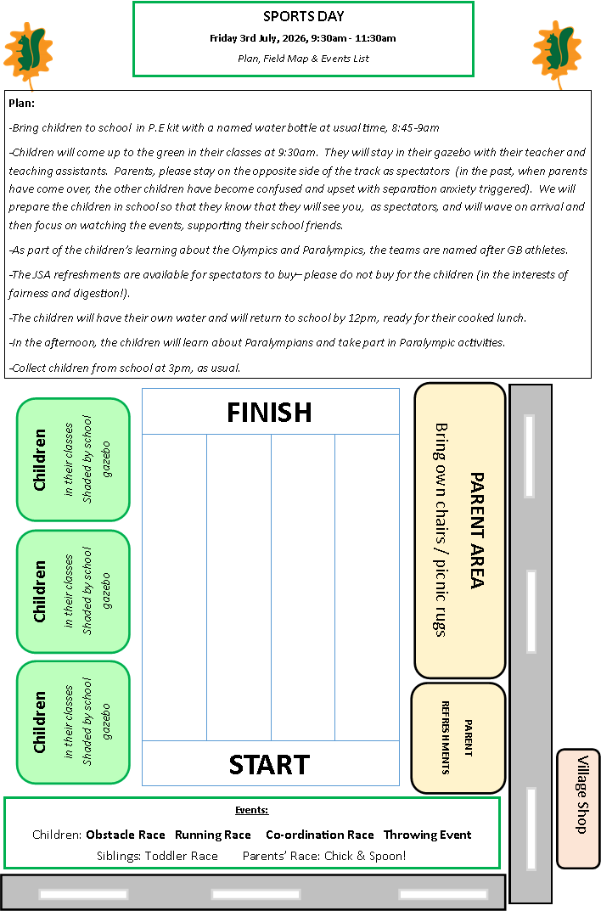
SPORTS DAY
The JSA are kindly organising cold drinks and treats for you to purchase on the day
via card reader or a QR code.

Slide 7




JORDANS VILLAGE PAGE

