Slide 1

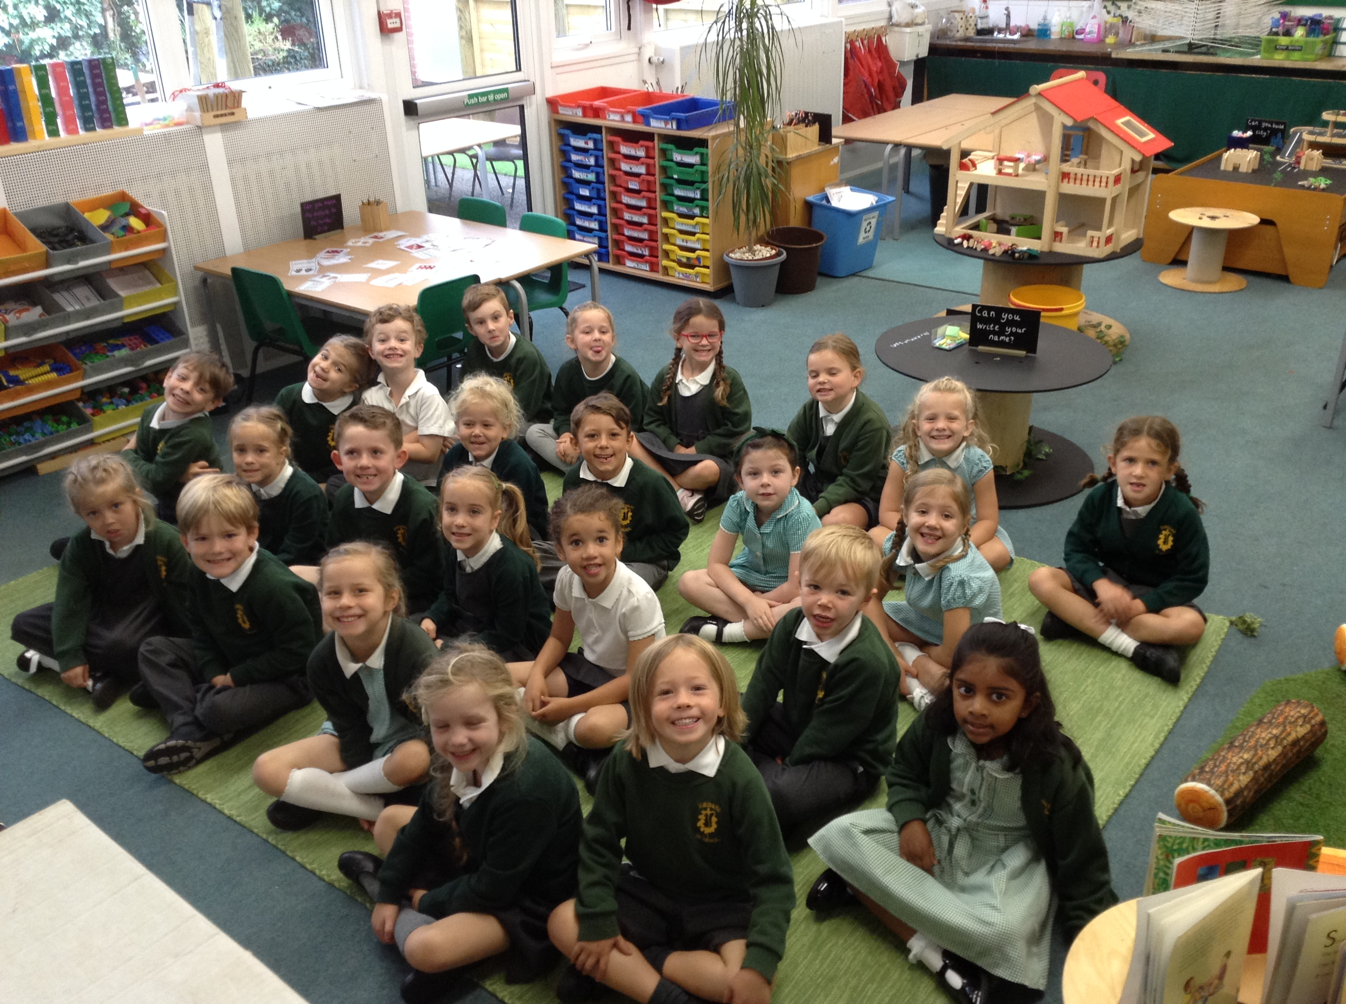
Welcome to Year 1

Slide 2
Drop off and Pick up
School gate open from 08:45 and will shut at 09:00.
Pick up from classroom door at 3pm

Slide 3
Our Day
Similar to Reception we are currently learning
through teacher led sessions on the carpet.
This is followed by small group work and
learning through play.

Slide 4
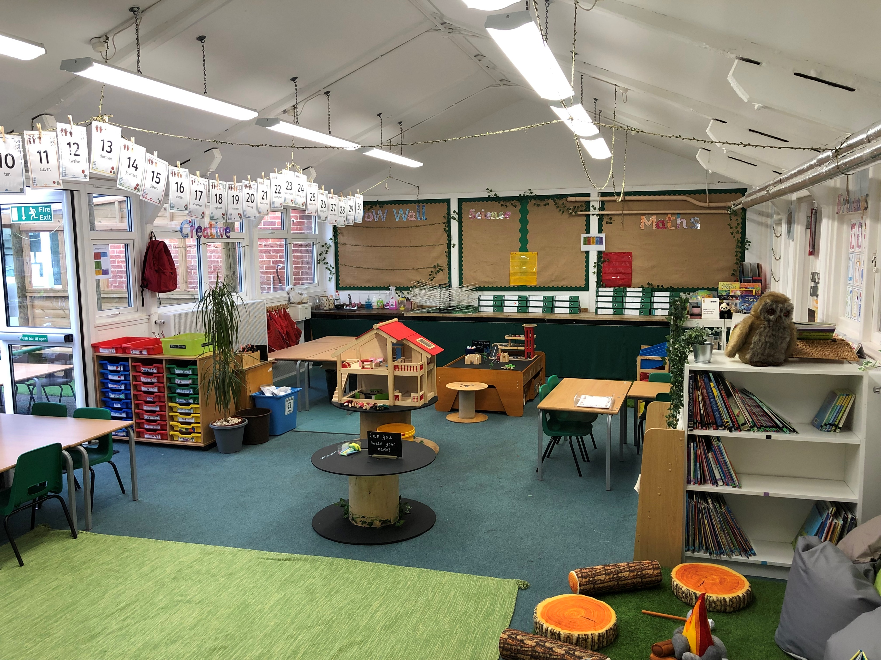
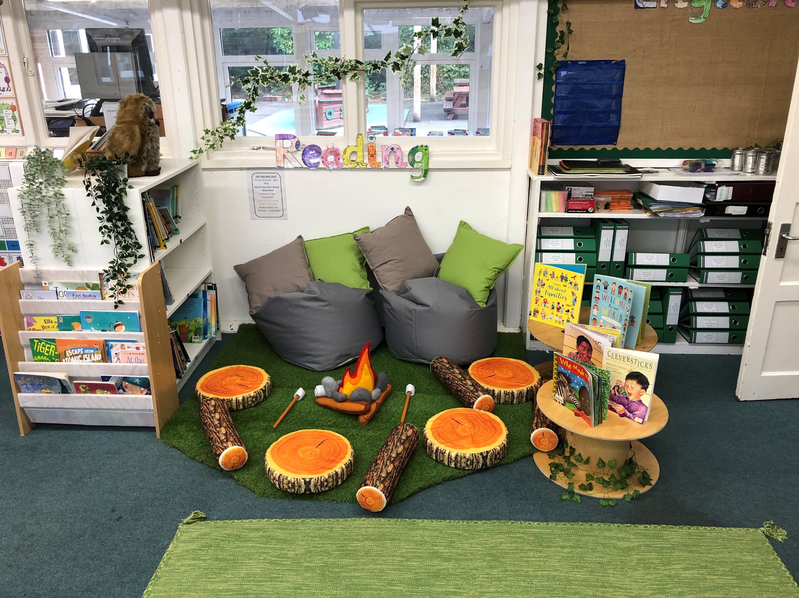
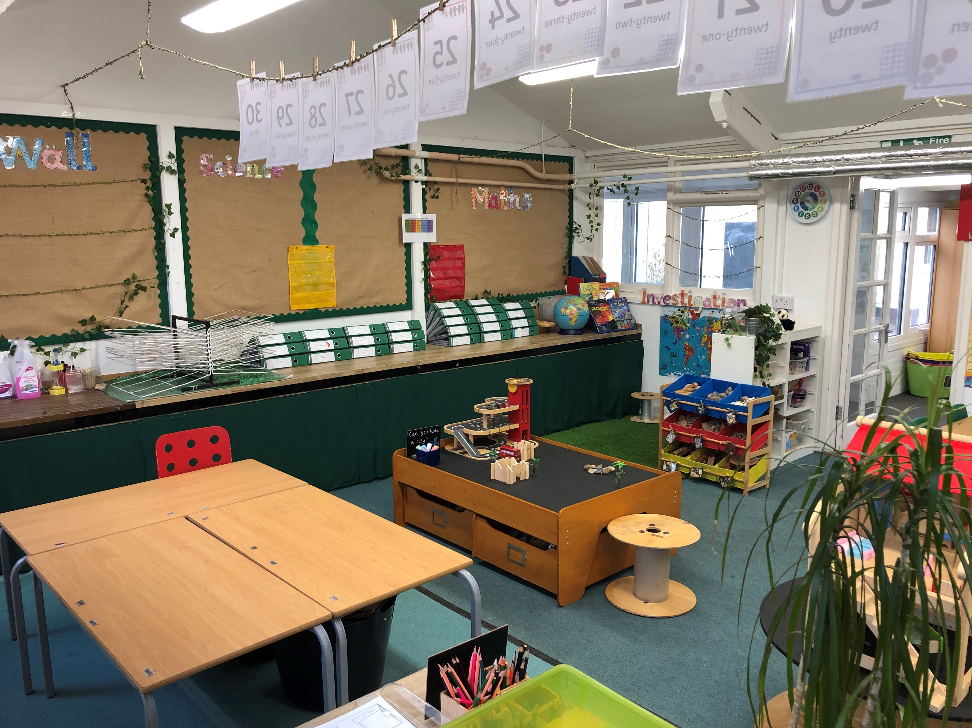
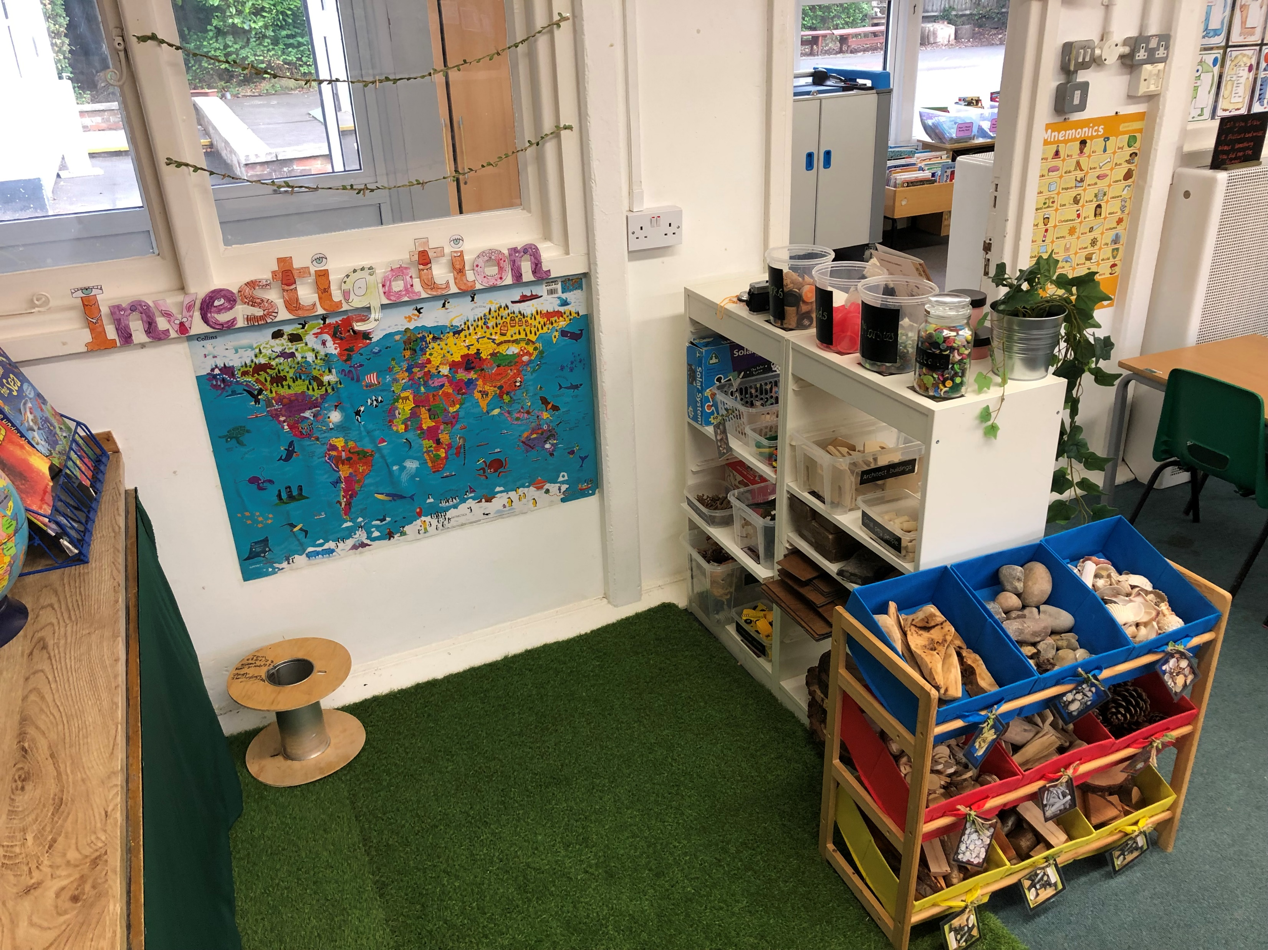
Our Classroom

Slide 5
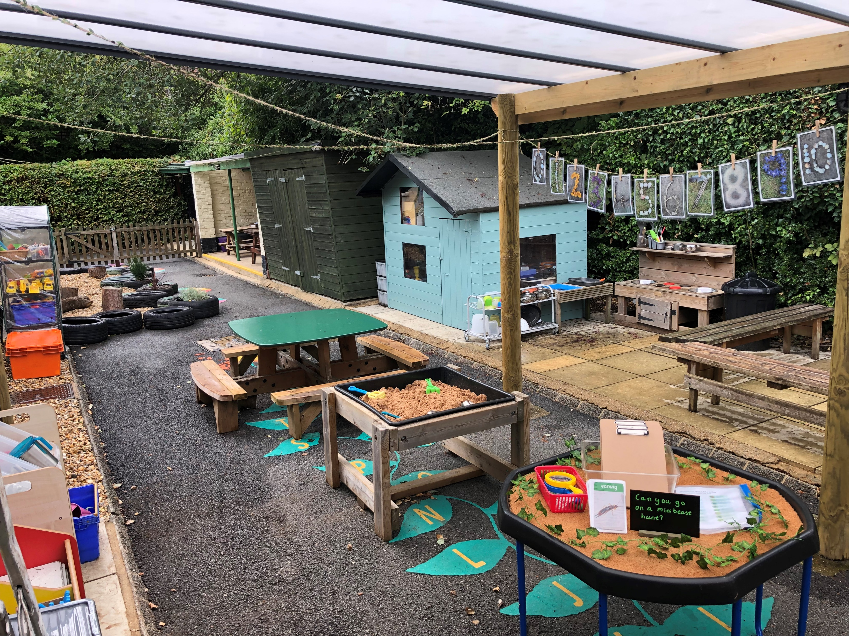
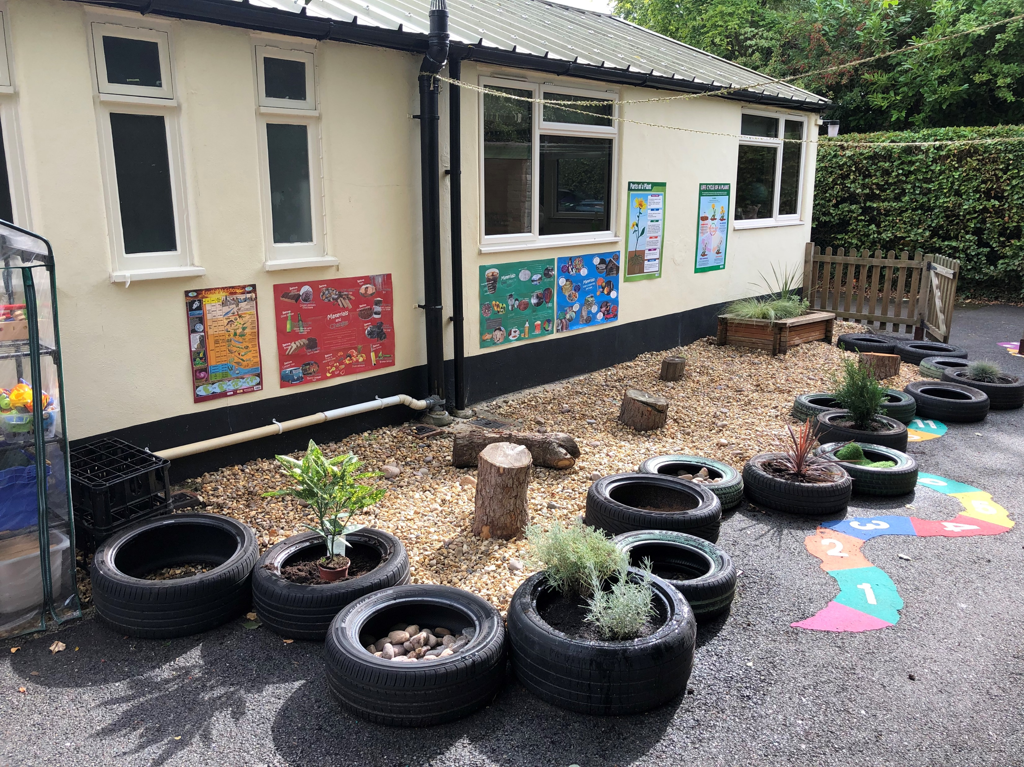
Our Outside Space

Slide 6
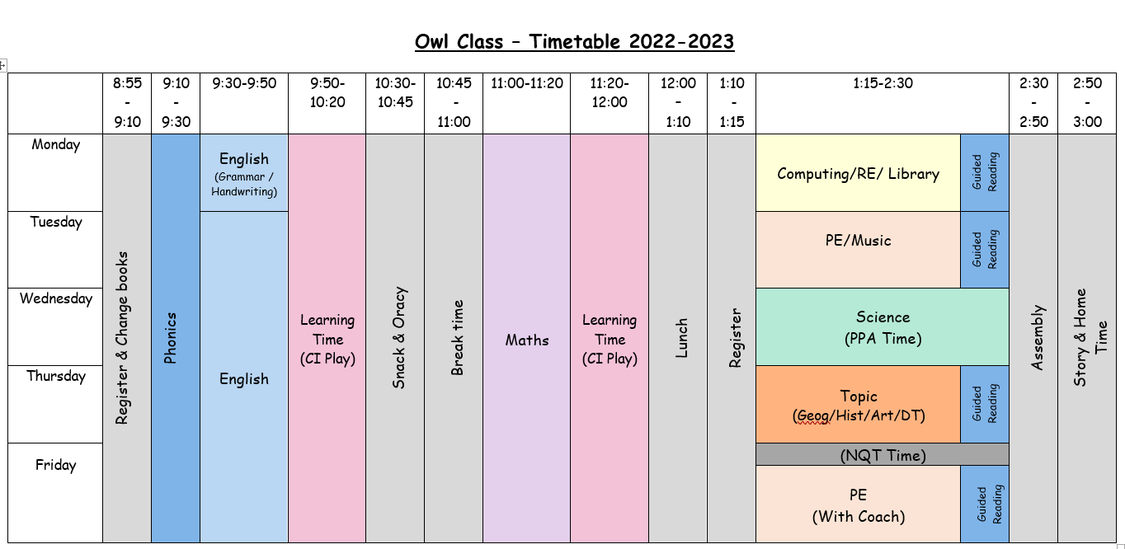
Our Timetable

Slide 7
Reading in Year 1
Read if possible with your child each evening for 15 minutes.
Reading books will be changed every Monday and Thursday.
Please read for decoding on day 1, read again for
comprehension on day 2 and read again for fluency and
expression on day 3.
The children’s reading books will be in line with their phonics
learning and writing practice, so books may have less words or
complex sentences.

Slide 8
Reading in Year 1
If you have any concerns regarding your child’s progress in reading
and their level, please do not write this in their reading records as
reading records are there for telling us about your child and their
love of reading! Instead, please do feel free to chat to the class
teacher who can answer any questions easily at the end of the
school day after the children have been dismissed.
As a school we take a mastery approach so rather than racing up
the reading levels, we go wide and encourage you to seek out a
variety of different reading opportunities for your child, e.g,
poems, songs, recipes, board game instructions…

Slide 9
Homework/Google Classroom in Year 1
For phonics, every week I will upload the Pupil Workbook from
the Twinkl Phonics Scheme. This will allow your
child to practice applying the previous week’s learnt sound.
Please don’t feel that you have to print the whole work book out.
It can be used as example activities and ideas, which can be
completed on a spare piece of paper.
I will also upload other activities that link to our current learning.

Slide 10
Maths in Year 1
At the beginning of the term a Maths newsletter/maths topic
sheet will be uploaded to the Owl Class page on the website.
Ways to support your child at home:
Practise counting (and in everyday situations)
Practise number formation
Practise number bonds
Practise exploring money and time

Slide 11
Writing in Year 1
Each morning children come straight into school and begin practising
their writing. We have recently began practising writing on this
template (sky letters, grass letters and ground letters).
Please continue to practise letter formation and name
writing at home.

Slide 12
PE in Year 1
Please check that your child has a complete PE kit and that
everything is labelled.
Please can any girls who wear tights have a spare pair of
socks in their PE bag.
PE is on a Tuesday and Friday.
Please continue to practise with your child getting changed at home.

Slide 13
Library Day
Our library day is Mondays, so please can your child bring in
in their library book every Monday.

Slide 14
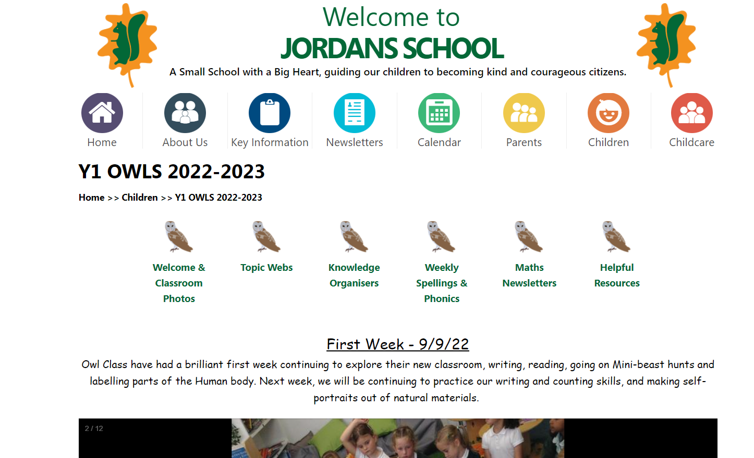
Contact
Useful information can be found on the website.

Slide 15
Contact
Always happy to speak to you and talk through any concerns or
queries no matter how big or small.
I am available after school, if you could please wait until all the
children have been dismissed.
Or alternatively email me owls@jordans.bucks.sch.uk
Thank you very much for sending in all the photos of your children,
we will be creating our own time lines next week!

